Slide 1
House Price Prediction System (A Machine Learning Project)
Mansi Jhaveri (60004178009)
Forum Shah (60004178018)

Slide 2
Topics to be covered :-
Introduction
About Dataset
Technologies used
Algorithms used
Flow of the project
Result Analysis
Conclusion
Future Scope

Slide 3
Introduction
House price prediction can help the developer determine the selling price of a house and can help the customer to arrange the right time to purchase a house.
This project predicts the efficient house pricing for real estate customers with respect to their budgets and priorities.
This system give us a good prediction on the price of the house based on other variables.

Slide 4
About Dataset
The dataset contains house sale prices and its features.
The dataset used for this system consists of 81 attributes and 1460 entries.
There are two datasets that are used in this system :-
-> Training dataset
-> Testing dataset
The system uses maximum features that are available in the dataset to predict the house prices well.

Slide 5


Technologies Used
Jupyter Notebook:-
-> A web-based interactive computational environment.
Python Language:-
-> Python is an interpreted, high-level, general-purpose programming
language.
-> Libraries used : pandas,numpy,seaborn,matplotlib.

Slide 6
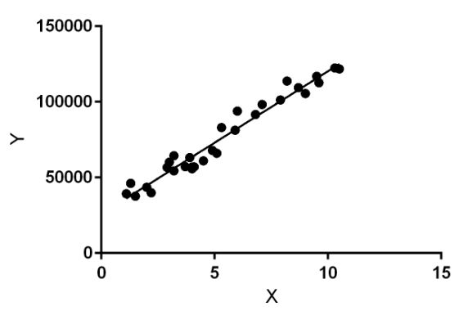
Algorithms Used
Regression Algorithm:-
->Regression algorithms fall under the family of Supervised Machine Learning algorithms which is a subset of machine learning algorithms. Regression algorithms predict the output values based on input features from the data fed in the system. The following regression algorithms are used for our project.
Linear regression:-
Random Forest regression:-
Gradient boosting regression:-

Slide 7
Linear regression
Linear Regression is a machine learning algorithm based on supervised learning.
It performs a regression task.
Regression models a target prediction value based on independent variables.
Linear regression performs the task to predict a dependent variable value (y) based on a given independent variable (x).

Slide 8
Random forest regression
A Random Forest is an ensemble technique capable of performing both regression and classification tasks.
It uses of multiple decision trees and a technique called Bootstrap Aggregation.
Bootstrap Aggregation is a machine learning algorithm designed to improve stability and accuracy of algorithms used in statistical classification and regression.
It involves training each decision tree on a different data sample where sampling is done with replacement.

Slide 9
Gradient Boosting Regression
Gradient boosting is a machine learning technique for regression and classification problems.
It produces a prediction model in the form of an ensemble of weak prediction models, typically decision trees.
Boosting can be interpreted as an optimization algorithm.

Slide 10
Flow of the project
Importing libraries
Analysis of target variables
Checking missing values
Correlation between trained attributes
Filling the missing values
Preparing data for prediction
Applied algorithms
Analysing the output

Slide 11
1.Importing libraries:-
The following libraries are imported:
Pandas
-Used for data manipulation and analysis.
Numpy
-Adds support for large,multi-dimensional arrays and matrices.
Seaborn
-Is a data visualization library based on matplotlib.
Matplotlib
-Used to create 2D graphs and plots by using python scripts.

Slide 12
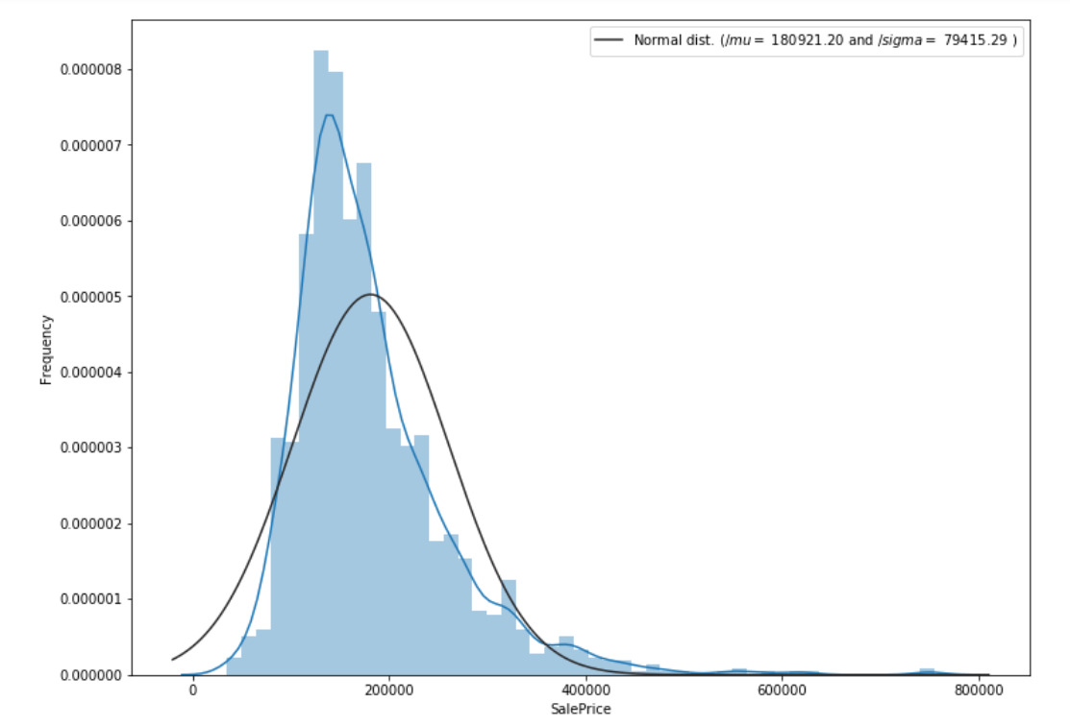
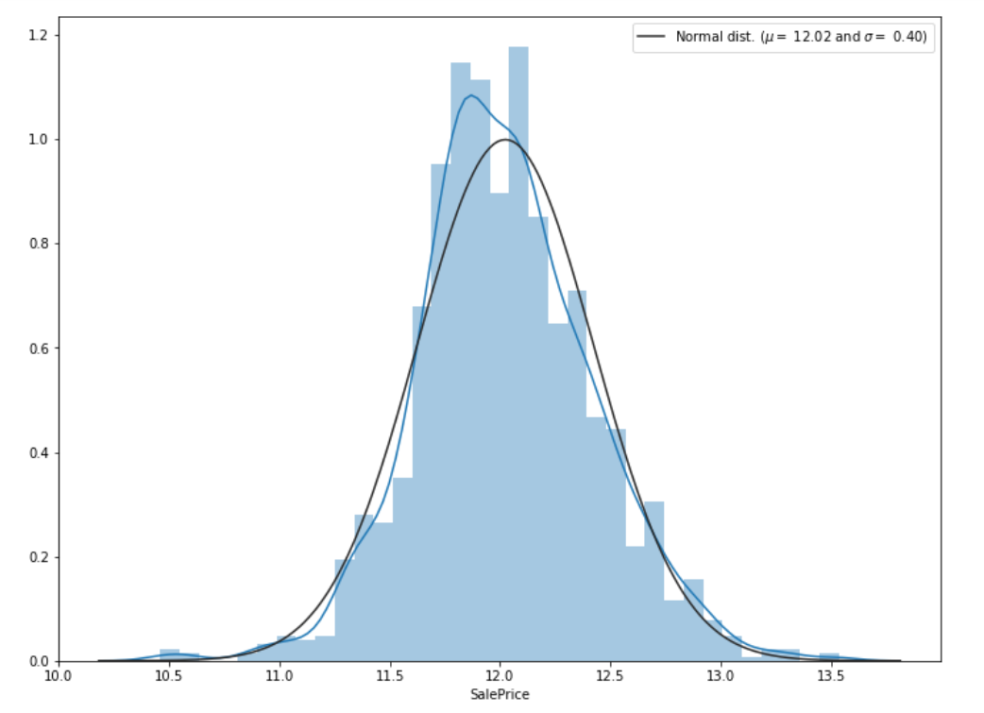
2. Analysis of target variables:-
Here SalePrice is the target variable.
Hence two graphs are plot considering SalePrice with frequency and without frequency.

Slide 13
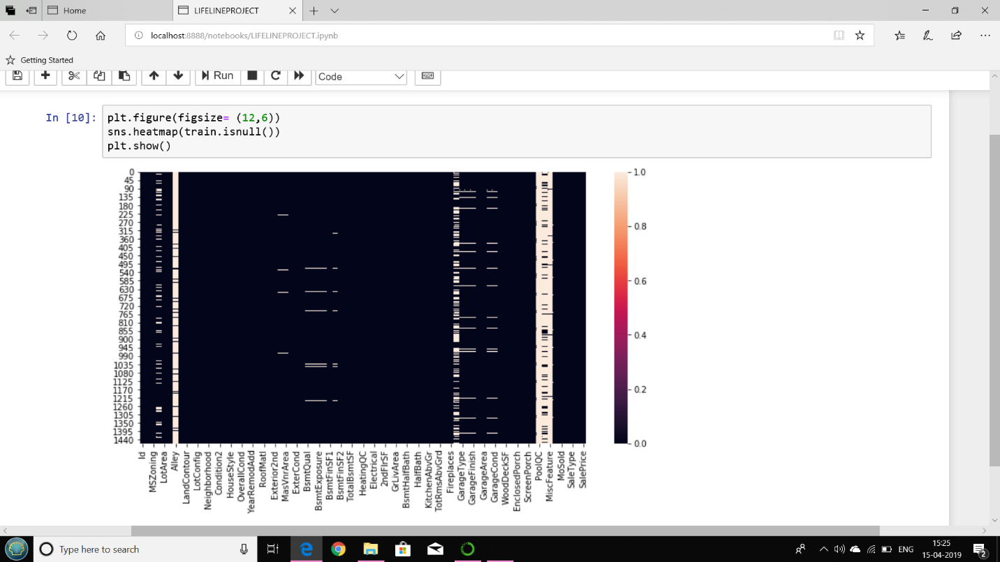
3. Checking missing values:-
Since the dataset is quite large, hence it will contain some null values.
Heat map is used to display the occurrence of the null values.

Slide 14
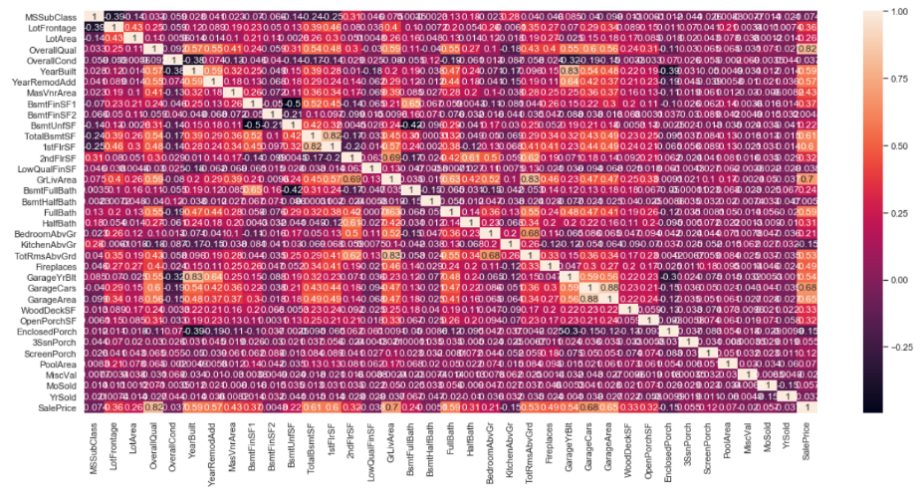
4. Correlation between trained attributes:-
Here we are using correlation matrix which is table showing correlation coefficients between variables.
It is also used to summarize data, as an input into a more advanced analysis, and as a diagnostic for advanced analyses.

Slide 15
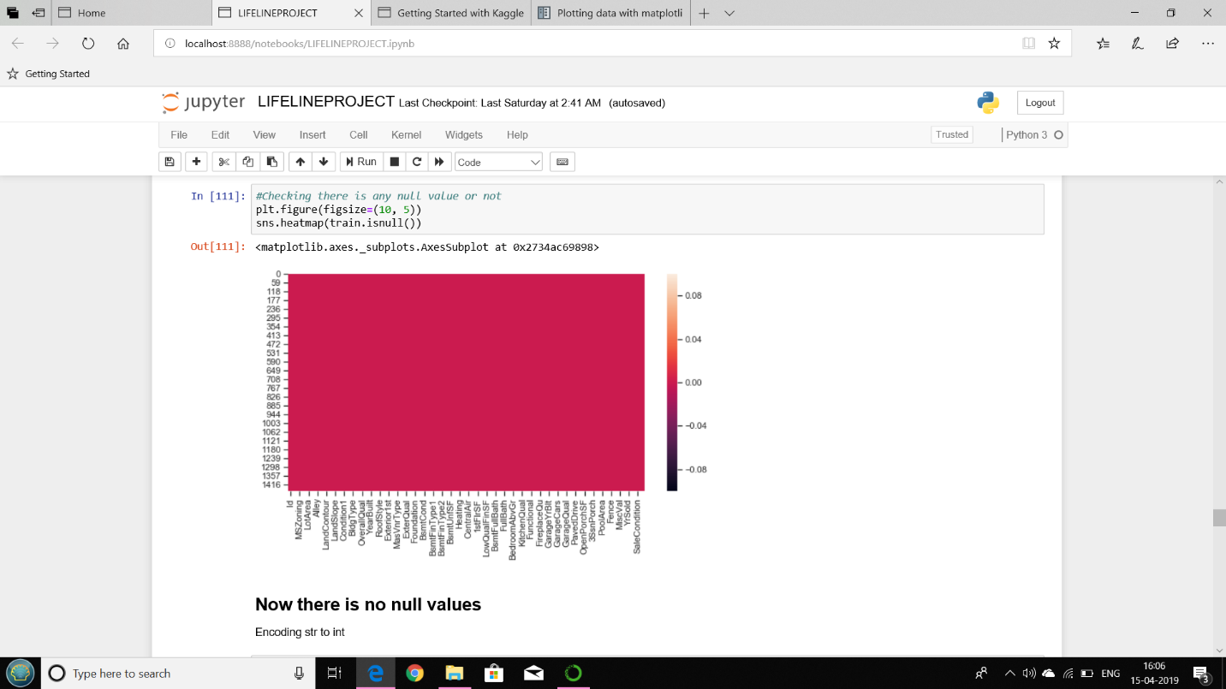
5. Filling the missing values:-
We are replacing all the null values from all the features of the dataset by none.
After filling the missing values, the heat map gets modified as:-

Slide 16
6. Preparing data for prediction:-
Algorithm:
Take target variable into y
Delete the sale price
Take their values in X and y
Split data into train and test format

Slide 17
7. Applied algorithms:-
After preparing data for predictions , we have tried to fit the model and predicted using linear regression initially followed by random forest regression.
Then accuracy of both the model have been calculated which concluded that linear regression is less accurate then random forest regression.
Hence we used gradient boosting regression algorithm and accuracy was increased.
Let us analyse the output after applying the these machine learning algorithms.

Slide 18
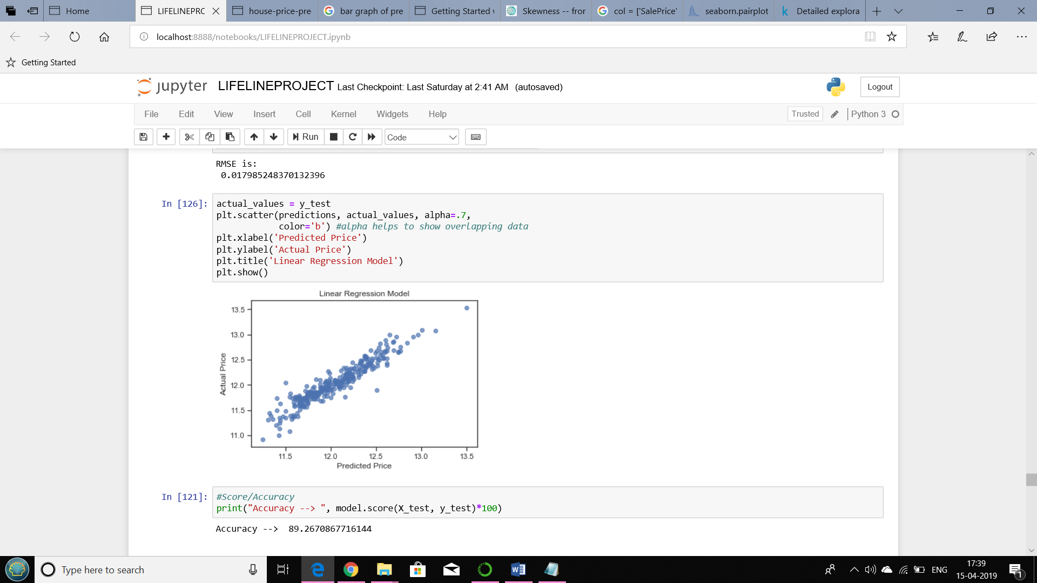
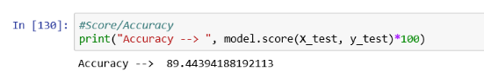
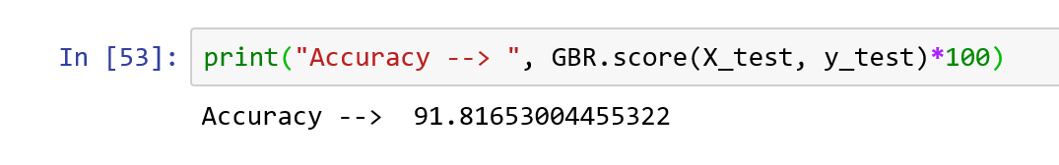
8. Analysing the output:-
Linear regression:
Random forest Regression:
Gradient boosting Regression:

Slide 19
Conclusion
Thus looking at the accuracy of all the three regression model,we conclude that Gradient boosting algorithm proves to be the best model to fit our dataset.
We are able to predict house price with around 91% accuracy for most of the cases.
The regression methods have been explored and compared, before arriving at a prediction method.
The success of our approach to creating a system for generating predictions can be applied to other problem sets concerned with geographical variations in the prediction mode

Slide 20
Future Scope
We can make a user interface using html, css ,php and javascript and we can use API calls to connect front end to backend.
Add more functionalities into the application :-
->We can also include latitude, longitude and elevation of the house in the model to predict the house price with more accuracy.
Optimise the prediction system through parallelised computations :-
->Rather than performing the computations sequentially, we can use multiple processors and parallelise the computations involved, which can potentially reduce the training time and prediction time.

